Slide 1
Analysis of Head Start Accessibility
Group : Dataminers
Member: Zizheng (Sean) Zhang
Yinming (Randall) Gao

Slide 2
Agenda
Background

Slide 3
Background
Established in 1965, Head Start promotes school readiness for children in low-income families by offering educational, nutritional, health, social, and other services. The program is rooted in urban, suburban, and rural communities throughout the nation.

Slide 4
Background (cont'd)
Service Mismatch: Only 30% of 3-to-5-year-olds and 9% of infants in poverty were served by Head Start.
COVID-19 Effect: A drop of 287,000 children in Head Start attendance in 2020-2021 compared to 2018-2019.
Funding Discrepancies: States with more child poverty receive less funding per child for Head Start.

Slide 5
Technologies In-use
Python: for data extraction, data analysis, and statistical modeling.
Tableau: for data visualization.
PowerPoint: for the presentation of insights.

Slide 6
Major Findings

Slide 7
Metrics
Children per Center
Fund per Child
Funding Index
Enrollment Rate
Center Coverage Rate

Slide 8
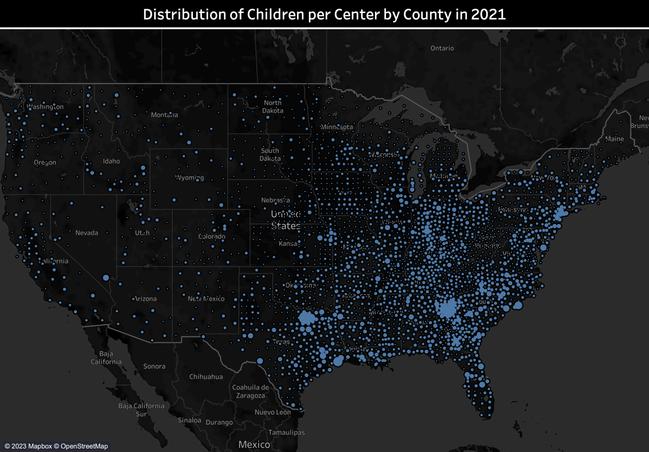
- Children/Center
- Texas & Georgia
- East & West

Slide 9
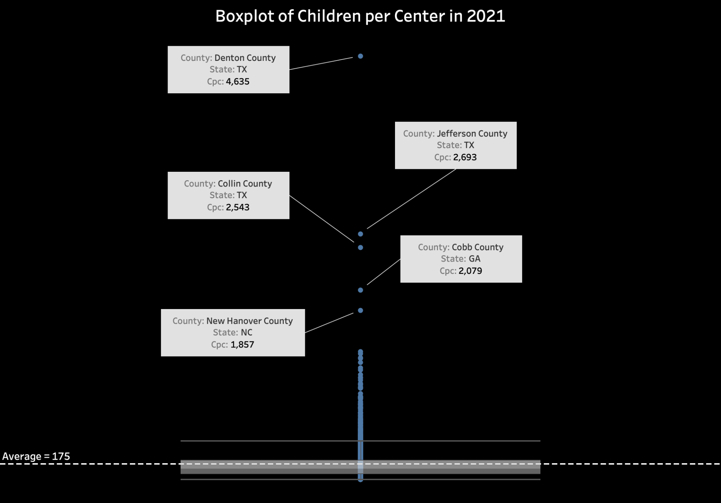

Slide 10
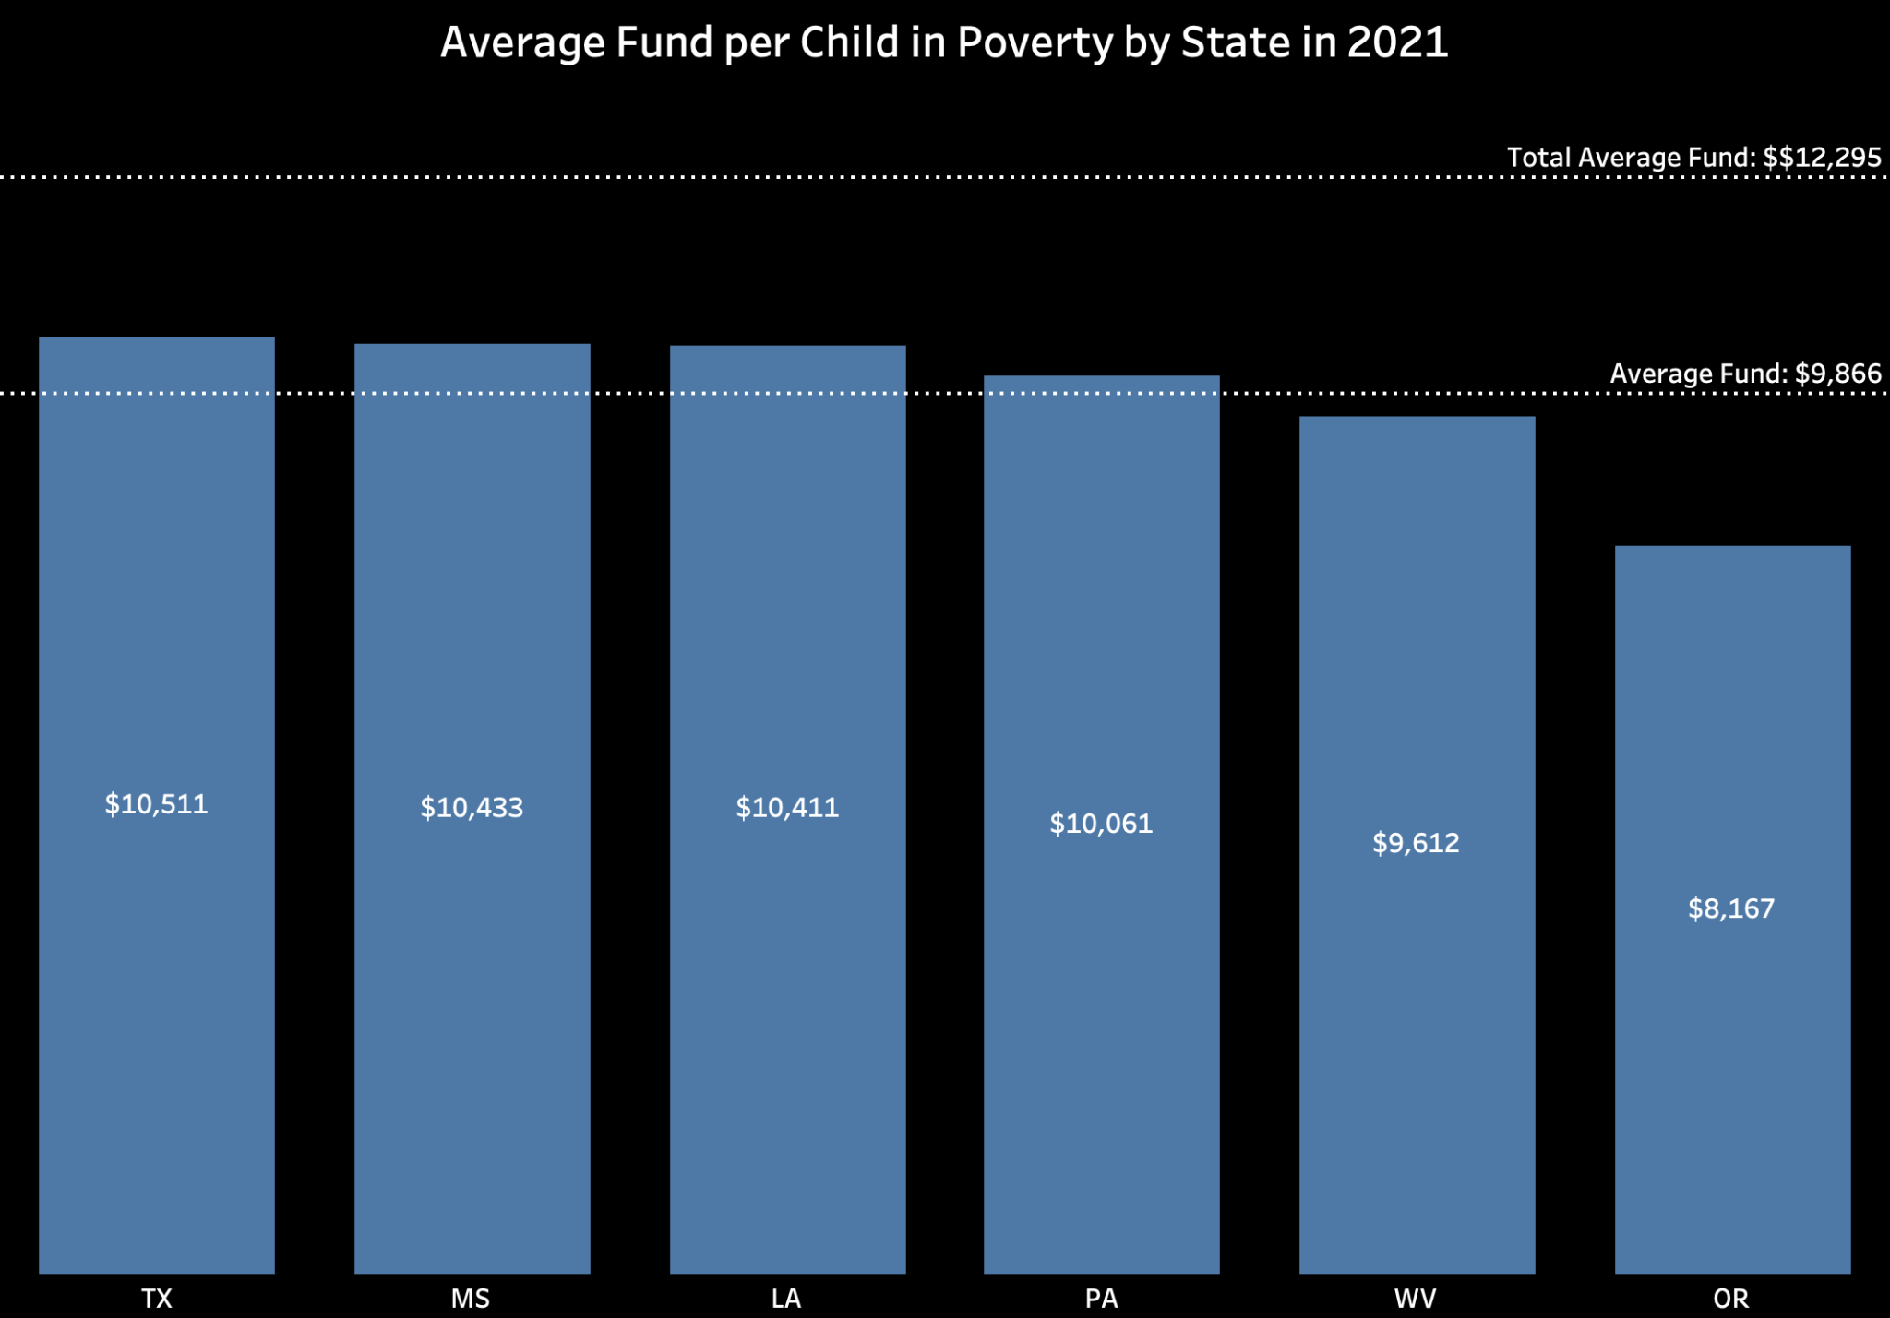
6 States with the Lowest Average Fund per Child

Slide 11
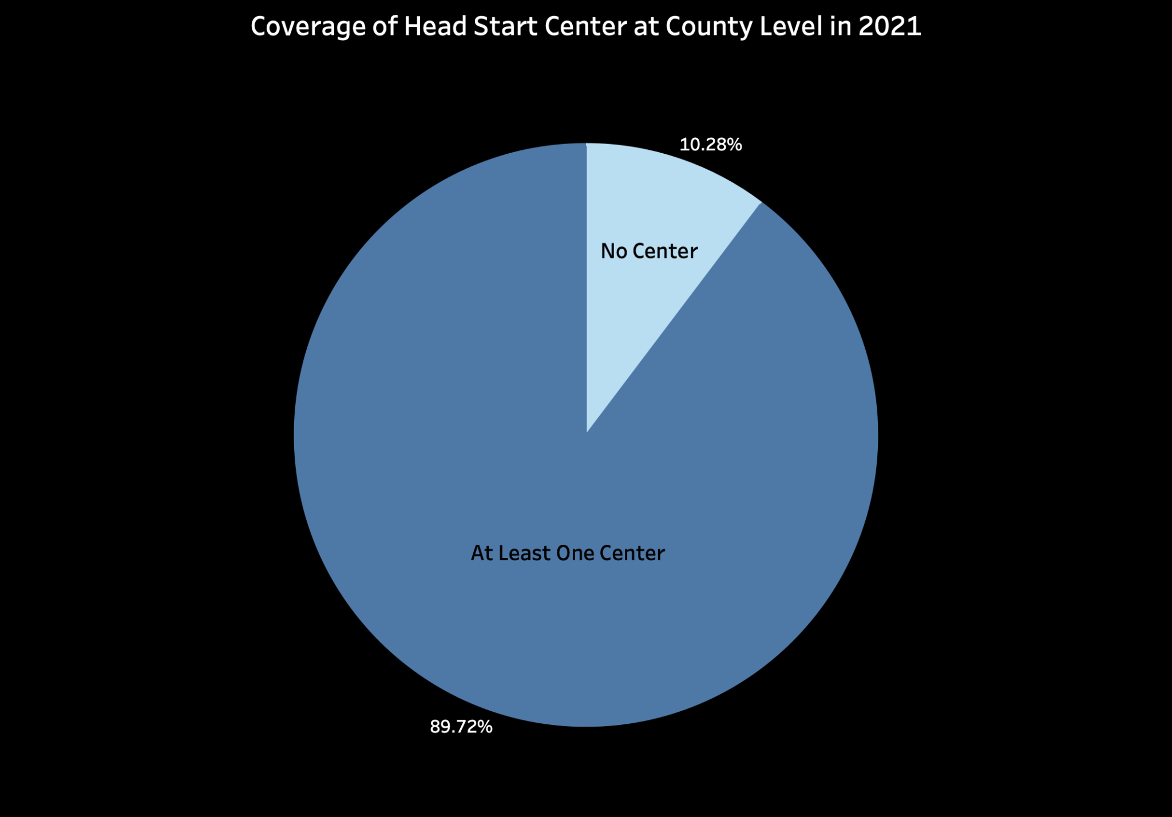
No Center: 315
At Least One Center: 2,748

Slide 12
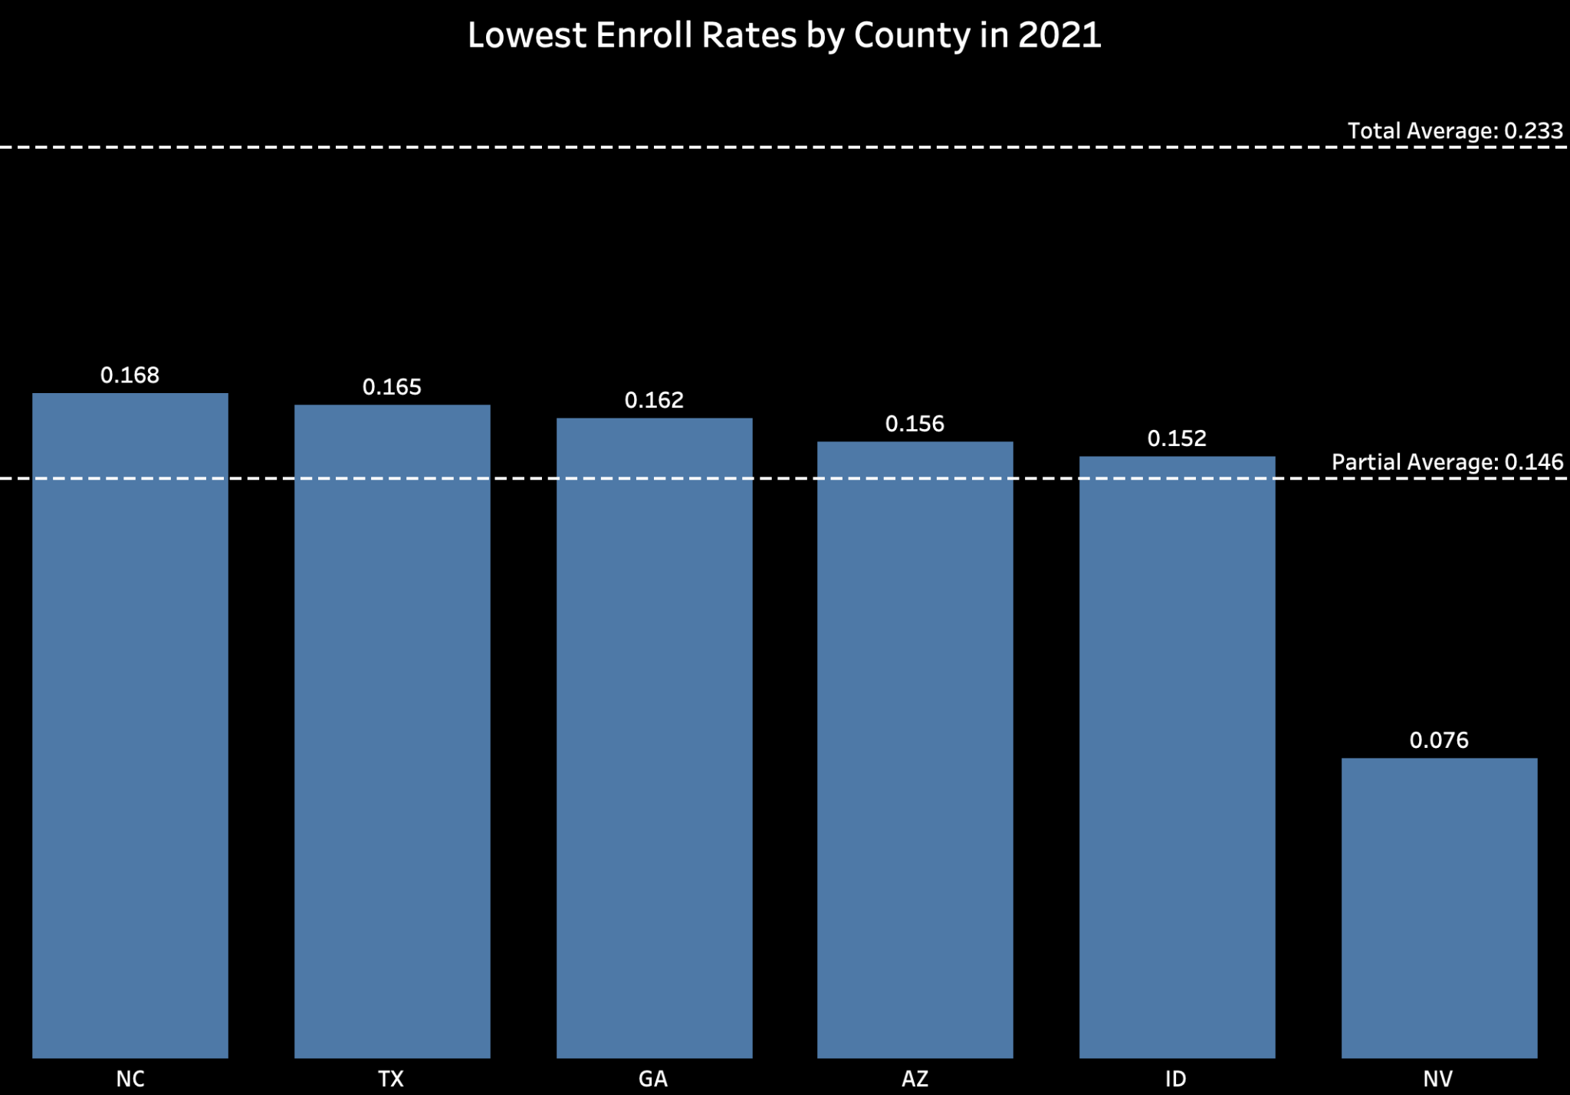
6 States with the Lowest Enroll Rates

Slide 13
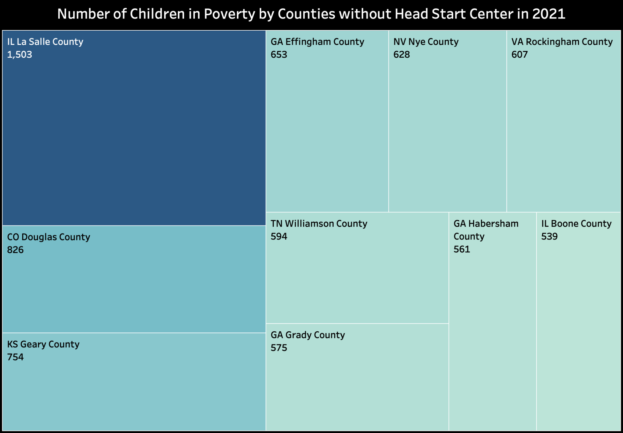
10 Counties without Head Start Center

